Slide 1
Computer graphics sec2
DR. Heba ElHadidi
Eng. Nayra Elmahlawy

Slide 2
Libraries
Graphics
Turtle
Open GL

Slide 3
Turtle Library
It is a library built into the python programming language and is used to create simple Two-Dimensional graphics such as lines, shapes, and texts.
Is a library with toolkit which provides simple and enjoyable way to draw on windows or screen which controlling a graphical entity with coordinates X,Y.
It provides a representation of a physical "turtle" (a little robot with a pen) that draws on the floor by moving forward and backward.

Slide 4
Turtle Library
Consist of :
TurtleScreen : defines graphics windows that provides a drawing surface for a turtle.
TurtleObjects : defines Turtle objects which draw on a TurtleScreen.

Slide 5
Turtle Screen
Function | Job
Screen( ) | Is a function used to show screen.
done( ) | Allow user to click a mouse and return where the mouse was clicked as a point .
setup(width, height, startx, starty) | Used to set the size and position of the screen window.
screensize(width, height, "color") | Is used to set the size of the turtle’s drawing canvas.
bgcolor (“color”) | Set or return background color of the TurtleScreen.
bgpic (“path_picture”) | Set the corresponding image as background.
Clearscreen\clear( ) | Delete all drawings and all turtles from the TurtleScreen. Reset the now empty TurtleScreen to its initial state.

Slide 6
Turtle
Function | Job
Turtle ( ) | Is a function used to draw turtle on the window
Shape() | Change the shape of mouse to turtle.
position ( ) | Is a function that returns the current position of the turtle on the window.
Color (pencolor , fillcolor) | Return the current pencolor and the current fillcolor as a pair of color specification strings or tuples, take zero, one or two parameters.
goto \ setpos \ setposition (x , y) | Move turtle to an absolute position and don’t change turtle orientation
forward \ fd(distance) | moving the turtle forward by specific distance.
backward \ bk (distance) | moving the turtle backward by specific distance.
right \ rt (angel) | Turn turtle right by angle units.
left \ lt(angel) | Turn turtle left by angle units.
hideturtle() | Hide the turtle after you're done.

Slide 7
Pen
Function | Job
pencolor(“color”) | color-string or color-tuple
pensize (width) = width ( ) | Set the line thickness to width or return it.
penup\up\pu ( ) | Pull the pen up – no drawing when moving.
pendown\down\pd ( ) | Pull the pen down – drawing when moving
speed(number) | number in range 0-10

Slide 8
Shapes
Function | Job
dot (size, color) | Draw a circular dot with diameter size, using color.
circle (radius, extent, steps) | Draw a circle with given radius.
fillcolor (“color”) | Return or set the fillcolor it can be string or rgb
begin_fill( ) | To be called just before drawing a shape to be filled.
end_fill ( ) | Fill the shape drawn after the last call to begin_fill( ).

Slide 9
Task

Slide 10
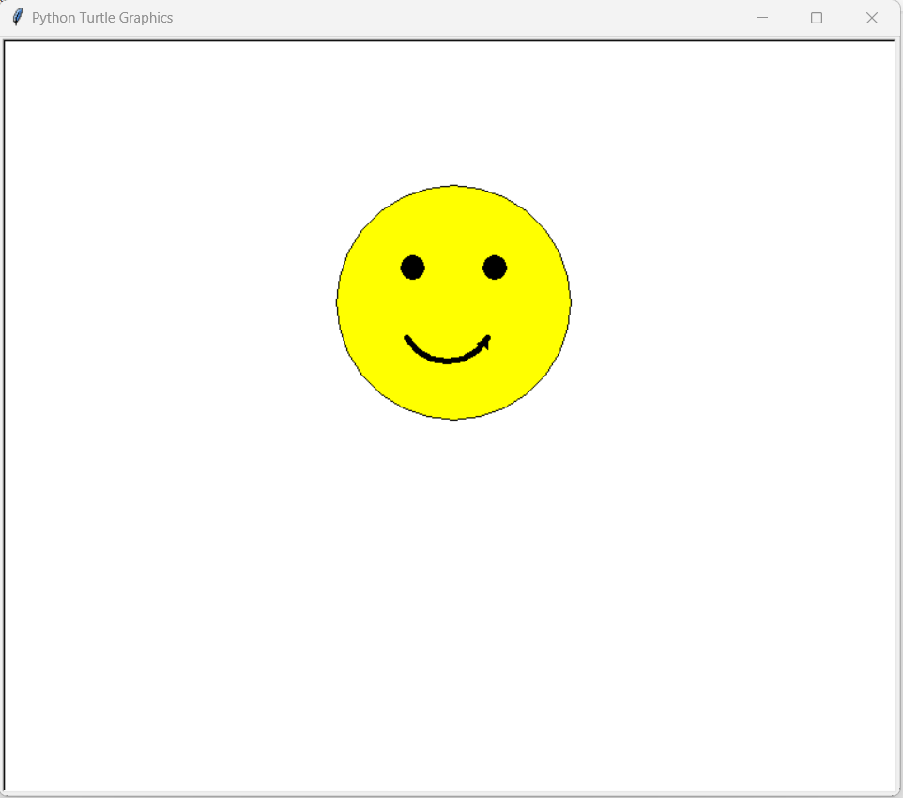

Slide 11
THANK YOU

